Slide 1
Real-Time E-Commerce Voicebot using LiveKit
Real-Time E-Commerce Voicebot using LiveKit
Talha | GenAI / RAG Engineer | Capstone Project

Slide 2
Why Voicebots in E-Commerce Are Hard
Voice is the fastest and most natural user interface
E-commerce support demands low latency and correctness
Traditional chatbots fail when converted to voice
Errors in voice systems damage user trust immediately

Slide 3
Challenges in Real-Time Voice AI Systems
Continuous audio streams (not request–response)
Partial speech & interruptions (barge-in)
Speech ambiguity (“ORT one zero zero one”)
Latency compounding across STT, LLM, and TTS
Preventing hallucinations for factual queries

Slide 4
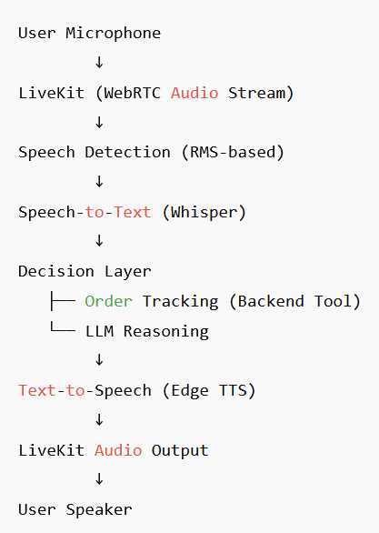
End-to-End Voicebot Architecture
“This pipeline ensures low latency, factual correctness, and a natural conversational experience in a real-time voice system.”

Slide 5
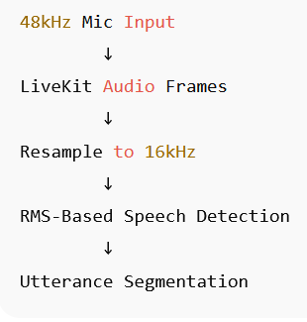
Real-Time Audio Handling Pipeline
DSP intentionally disabled
Streaming, not batch audio
Designed for low-latency response
“We never wait for the user to ‘finish talking’ — the system reacts continuously.”

Slide 6
Speech-to-Text Pipeline (Whisper-Based)
Continuous audio streamed from LiveKit in real time
Audio resampled from 48kHz → 16kHz mono PCM
RMS-based speech detection segments utterances
Raw PCM audio converted to float32 format
Whisper transcribes audio directly from memory
Text output forwarded immediately to decision layer

Slide 7
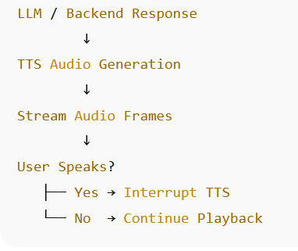
Text-to-Speech & Interruption Handling

Slide 8
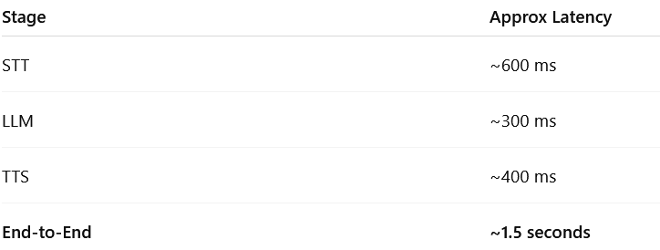
Latency Breakdown
“Streaming reduces perceived latency significantly.”

Slide 9
Safety & User Experience
How This Would Scale in Production
Graceful fallback on unclear speech
No fabricated order status
Clarification prompts
Stable behavior under noise
Dockerized agent per room
Horizontal scaling
Token-based authentication
Observability & logging
Database-backed RAG

Slide 10
Questions ?

Slide 11
Thank You!

